Slide 1




INFRARED SENSOR(IR)
SUBMITTED BY:
H.M. TAHSIN SHEIKH
ID: 22201243
SEC: E
COURSE CODE : CSE 437
SUBMITTED TO:
A.S. ZAFORULLAH MOMTAZ ASSISTANT PROFESSOR DEPARTMENT OF CSE UNIVERSITY OF ASIA PACIFIC

Slide 2

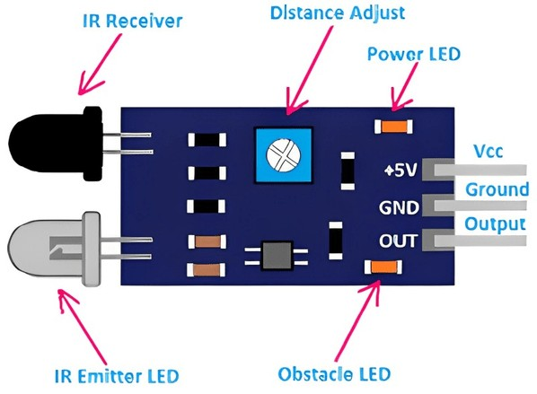
INTRODUCTION
  An Infrared (IR) sensor is an electronic device used to detect infrared radiation.
  It can sense objects, motion, and heat without physical contact.
  IR sensors are widely used inrobotics, automation, and security systems.

Slide 3
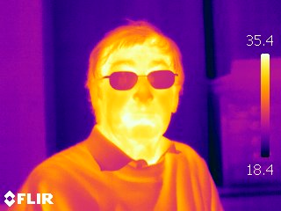
WHAT IS INFRARED RADIATION?
  Infrared is a type of electromagnetic wave Wavelength range: 700 nm – 1 mm Invisible to humaneyes
  Emitted by all warm objects

Slide 4
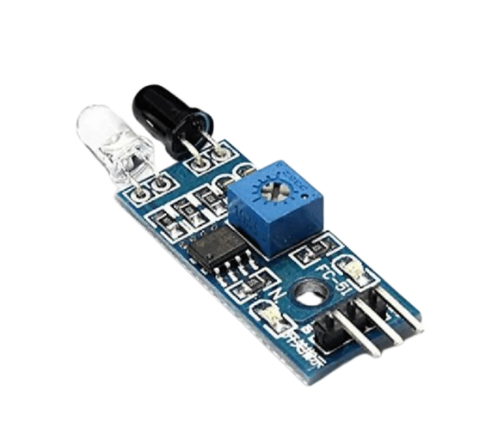
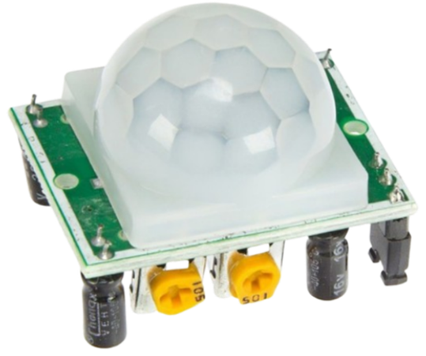
TYPES OF IR SENSORS
ACTIVE IR SENSOR
USES IR TRANSMITTER AND RECEIVER USED FOR OBSTACLE DETECTION
PASSIVE IR SENSOR (PIR)
DETECTS HEAT FROM OBJECTS USED FOR MOTION DETECTION

Slide 5
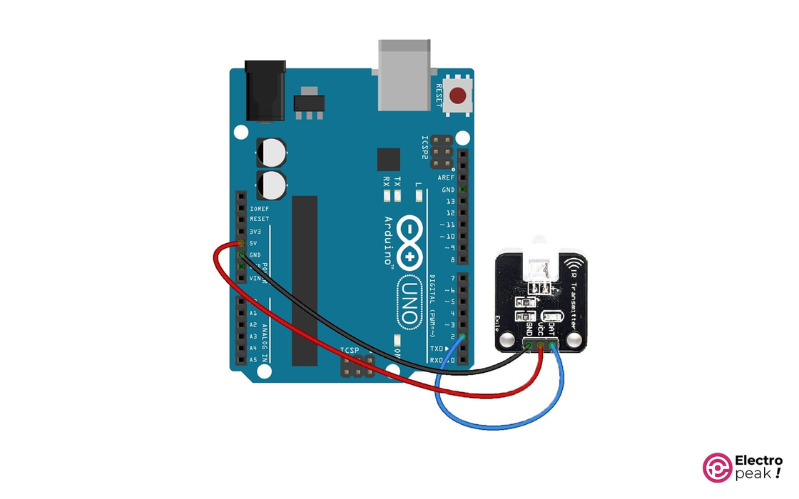
COMPONENTS OF IR
IR Transmitter (IR LED)
IR Receiver (Photodiode / Phototransistor) LM358 Comparator IC
Potentiometer (Sensitivity control) OutputLED
VCC, GND, OUT Pins

Slide 6
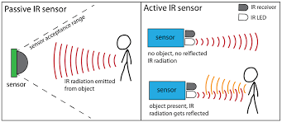
WORKING METHODOLOGY
1.IR LED EMITS INFRARED RADIATION
2.RADIATION STRIKES AN OBJECT
3.REFLECTED IR LIGHT IS RECEIVED BY THE PHOTODIODE
4.LM358 COMPARATOR COMPARES SIGNAL WITH REFERENCE
5.OUTPUT CHANGES TO HIGH OR LOW
6.MICROCONTROLLER READS THE OUTPUT

Slide 7
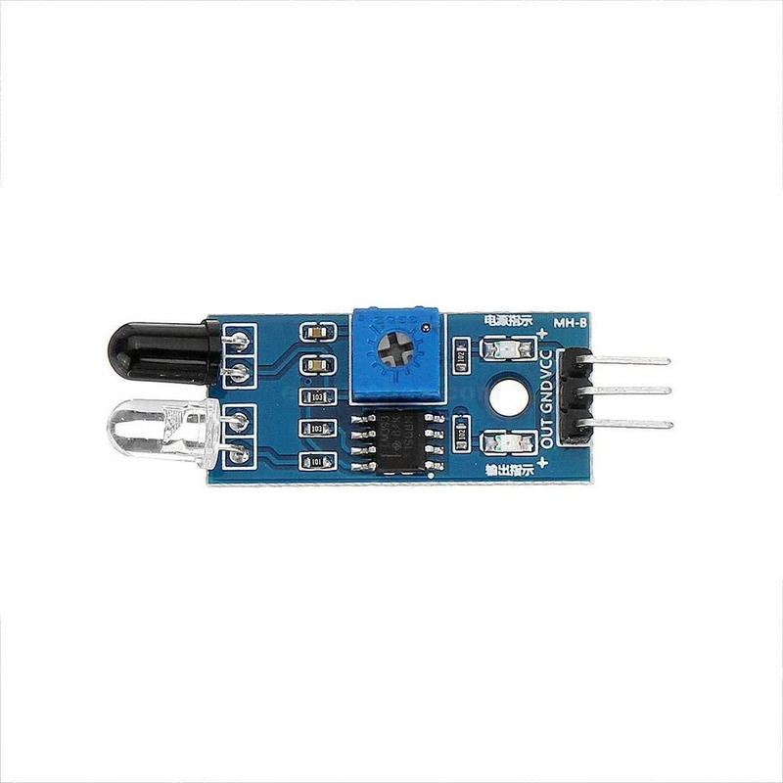
FEATURES
  Power Supply: +5V DC Quiescent Current: < 2mA Working Current: 15mA Effectual Angle: < 15°
  Ranging Distance: 2 cm – 400 cm / 1″ – 13 ft Resolution: 0.3 cm
  Measuring Angle: 30°
  Trigger Input Pulse Width: 10 µs Dimensions: 45 mm × 20 mm × 15 mm

Slide 8
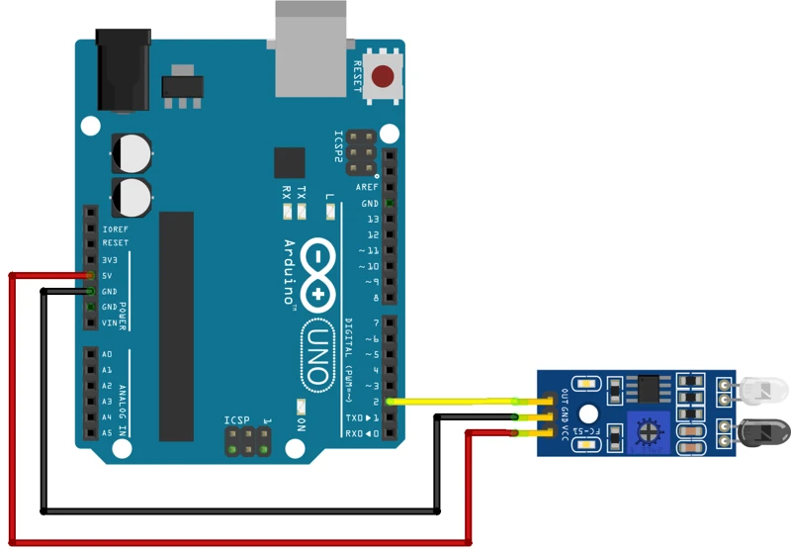
DIAGRAM
CONNECTIONS:
IR VCC → ARDUINO 5V
IR GND → ARDUINO GND
IR OUT → ARDUINO DIGITAL PIN 7

Slide 9
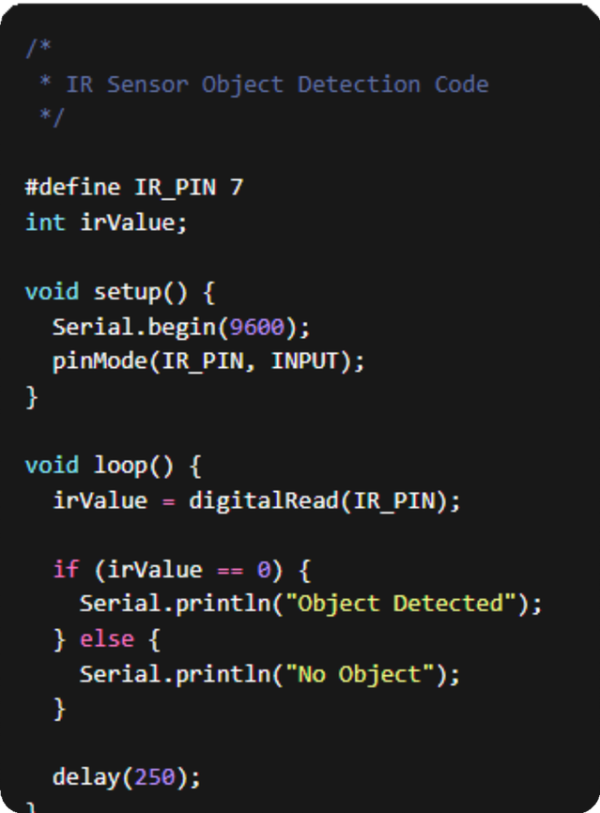
LIBRARY INSTALLATION
1.CONNECT THE IR SENSOR TO YOUR ARDUINO.
2.OPEN ARDUINO IDE.
3.SELECT YOUR BOARD:
4.TOOLS ➜ BOARD ➜ ARDUINO UNO
5.SELECT CORRECT COM PORT:
6.TOOLS ➜ PORT ➜ (YOUR PORT)
7.COPY THE CODE BELOW.
8.CLICK UPLOAD.
9.OPEN SERIAL MONITOR (9600 BAUD RATE).

Slide 10

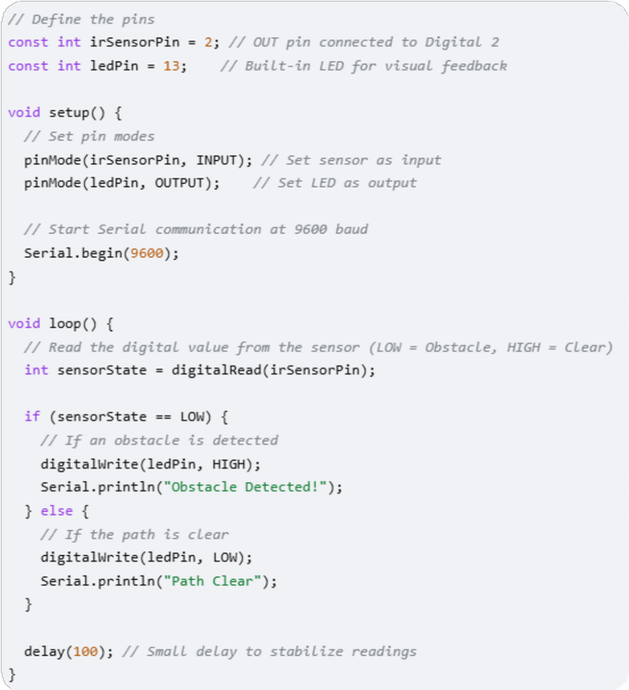
CORE CODE
OBSTACLE AVOIDANCE ROBOT (ARDUINO)
IR PROXIMITY SECURITY ALARM (BUZZER)

Slide 11

THANK YOU
“An IR sensor is a low-cost and reliable device that detects objects using infrared light. It is widely used in automation, robotics, and security systems to improve efficiency and safety.”
https://www.youtube.com/watch?v=t7k9D1jDEtk

